Slide 1
Lecture 1

Slide 2
Disk Storage, Basic File Structures and Hashing

Slide 3
Introduction
Databases typically stored on magnetic disks as file of records. But, one should know
How storage is done on hard disk?
Which techniques should be used for faster access?
Storage Medium/hierarchy

Slide 4

Types of storage devices

Slide 5
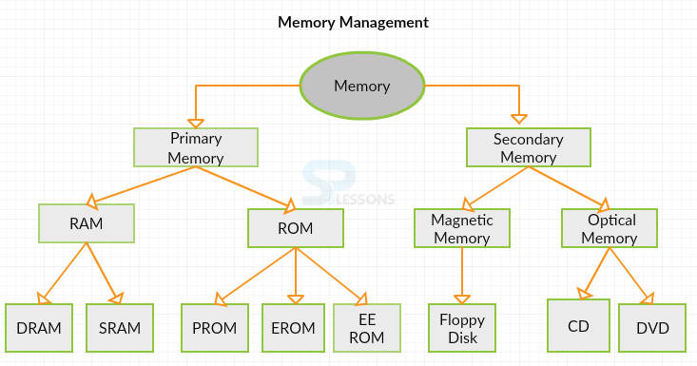
Storage memory and its types

Slide 6
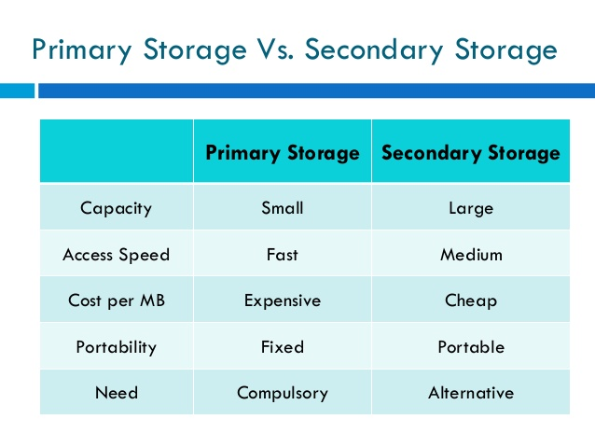
Primary memory vs. Secondary Memory

Slide 7
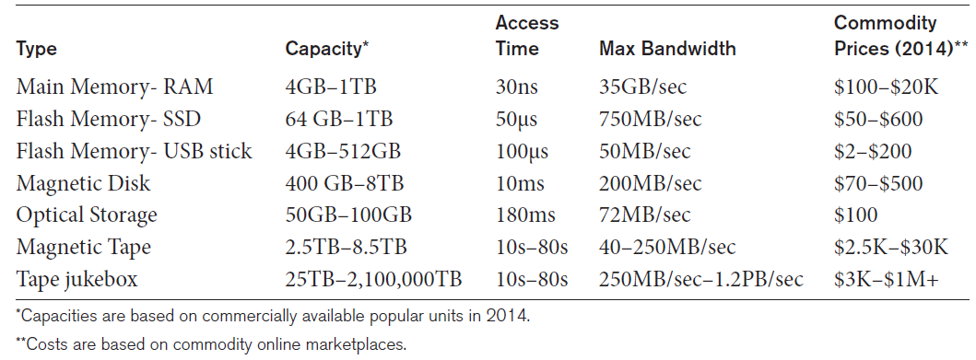
Storage Types and Characteristics
Types of Storage with Capacity, Access Time, Max Bandwidth (Transfer Speed), and Commodity Cost

Slide 8
Storage Organization of Databases
Persistent data
Most databases
Transient data
Exists only during program execution
File organization (Physical file organization)
Determine how the file records are physically placed on the disk, and hence how the records can be accessed
A heap file (unordered file), sorted file (sequential file) and hashed file are the primary file organization techniques.

Slide 9
Secondary Storage Devices
Hard disk drive: The most basic unit of data on the disk is a single bit of information
To code information, bits are grouped into bytes (or characters)
The capacity of a disk is the number of bytes it can store .
Disks may be single or double-sided
Concentric circles called tracks
Tracks divided into blocks or sectors
Disk packs
To increase storage capacity, disks are assembled into a disk pack
Tracks with the same diameter on the various surfaces are called a cylinder

Slide 10
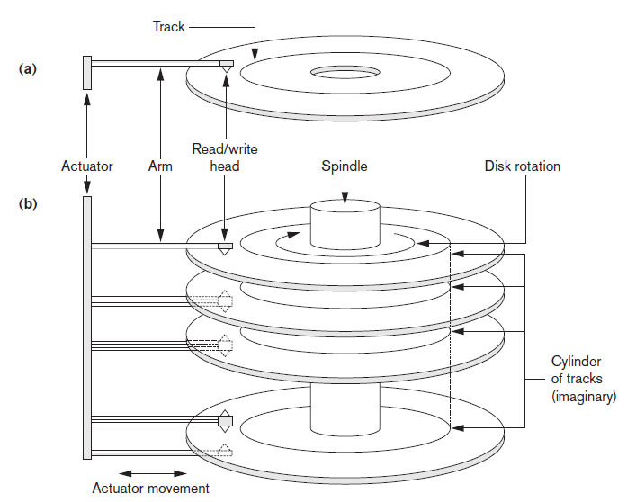
Single-Sided Disk and Disk Pack
A single-sided disk with read/write hardware (b) A disk pack with read/write hardware

Slide 11
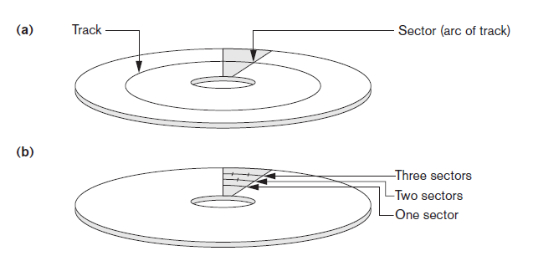
Sectors on a Disk
Different sector organizations on disk (a) Sectors subtending a fixed angle (b) Sectors maintaining a uniform recording density

Slide 12
Secondary Storage Devices (cont’d.)
Formatting
Divides tracks into equal-sized disk blocks (or pages)
Blocks separated by interblock gaps: which include specially coded control information written during disk initialization
Typical disk block sizes range from 512 to 8192 bytes
Data transfer in units of disk blocks
Transfer of data between main memory and disk.
The hardware address of a block—a combination of a cylinder number, track number (surface number within the cylinder on which the track is located), and block number (within the track) Hardware mechanism for read and write operations
Buffer
A contiguous reserved area in main storage that holds one disk block

Slide 13
Disk controller performance parameters
Seek Time: To transfer a disk block, given its address, the disk controller must first mechanically position the read/write head on the correct track. The time required to do this is called the seek time.
Rotational Delay/latency: The time required to position the read/write head at the beginning of the desired block
Block Transfer Time (BTT): The total time needed to locate and transfer an arbitrary block, given its address, is the sum of the seek time, rotational delay, and block transfer time
Bulk Transfer Rate (BTR): the time required to transfer consecutive blocks

Slide 14
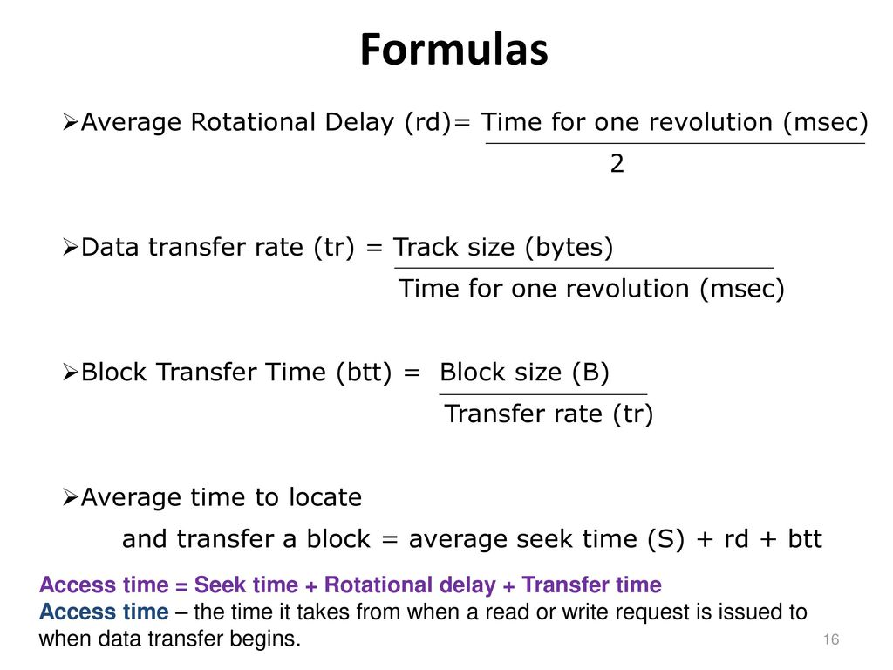

Slide 15
Practice Question
Consider a disk with the following characteristics (these are not parameters of any particular disk unit): block size B = 512 bytes; interblock gap size G = 128 bytes; number of blocks per track = 20; number of tracks per surface = 400. A disk pack consists of 15 double-sided disks.
a) What is the total capacity of a track, and what is its useful capacity (excluding interblock gaps)?
Total Capacity =(512+128)*20 =12800 = 12.8 Kbytes
Useful capacity of a track=512*20 = 10240 = 10.24 Kbytes
b) How many cylinders are there?
Number of cylinders = number of tracks = 400
c) What are the total capacity and the useful capacity of a cylinder?
Total cylinder capacity =: (512+128)*20*15*2=384000 = 384 KB
Useful cylinder capacity =: 512*20*15*2=307200 = 307.2 KB

Slide 16
Practice Question Continued…
d) What are the total capacity and the useful capacity of a disk pack?
Total capacity of a disk pack =: (512+128)*20*400*15*2=153600000 =>153.6MB Useful capacity of a disk pack =: 512*20*400*15*2=122880000 =>122.88MB
e) Suppose that the disk drive rotates the disk pack at a speed of 2400 rpm(revolutions per minute); what are the transfer rate (tr) in bytes/msec and the block transfer time (btt) in msec? What is the average rotational delay (rd) in msec? What is the bulk transfer rate?
Transfer rate tr= (12800 bytes)/(60*2400rpm)*1000msec/sec = 88.9bytes/msec block transfer time btt=B*tr=(512)/88.9= 5.76 msec
average rotational delay rd ==1/2*(1/2400)*60*1000= 12.5 msec
f) Suppose that the average seek time is 30 msec. How much time does it take (on the average) in msec to locate and transfer a single block, given its block address?
average time to locate and transfer a block=btt+rd+st=5.76+12.5+30=48.26msec

Slide 17
Practice Question Continued…
g) Calculate the average time it would take to transfer 20 random blocks and compare it with the time it would take to transfer 20 consecutive blocks using double buffering to save seek time and rotational delay of 17.28
time to transfer 20 random blocks = 20 * (s + rd + btt) = 20 * 43.5 = 870 msec time to transfer 20 consecutive blocks using double buffering = s + rd + 20*btt = 30 + 12.5 + (20*1) = 62.5 msec

Slide 18
Placing File Records on Disk
Record: collection of related data values or items
Values correspond to record field
Data types
Numeric
String
Boolean
Date/time
Binary large objects (BLOBs)
Unstructured objects

Slide 19
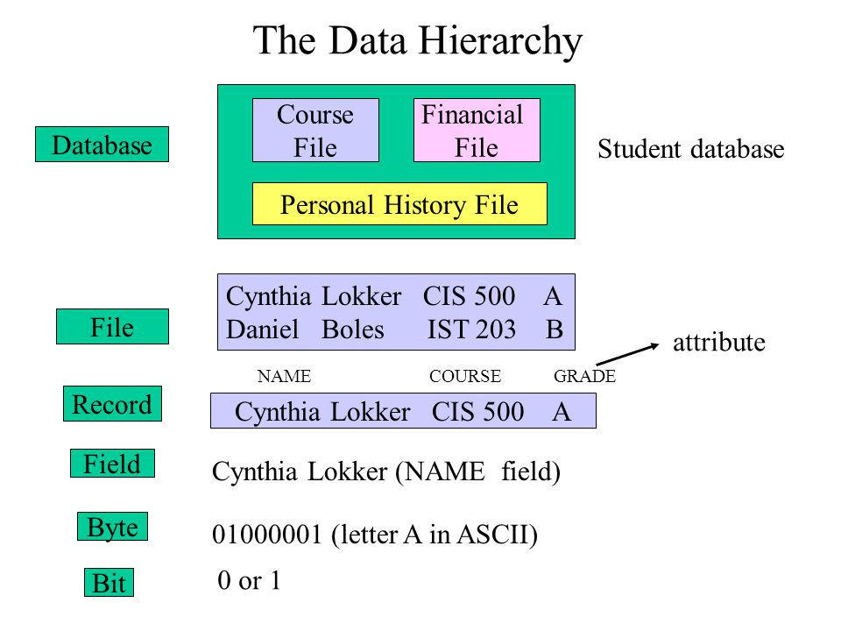

Slide 20
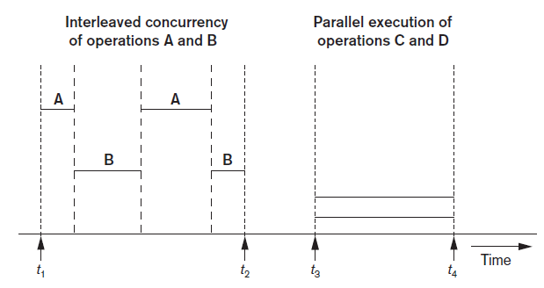
Buffering of Blocks
Buffering most useful when processes can run concurrently in parallel
Interleaved concurrency versus parallel execution

Slide 21
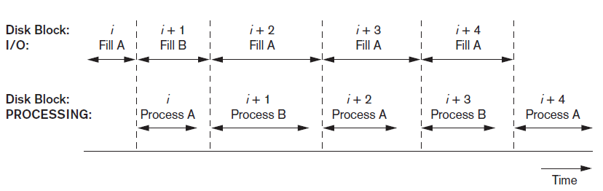
Buffering of Blocks (cont’d.)
Double buffering can be used to read continuous stream of blocks
Use of two buffers, A and B, for reading from disk

Slide 22
Placing File Records on Disks
Record and Record Types
Fixed Length
Variable Length:
Reasons for variable-length records
One or more fields have variable length
One or more fields are repeating
One or more fields are optional
File contains records of different types
Buffer replacement strategies
Least recently used (LRU)
Clock policy
First-in-first-out (FIFO)

Slide 23
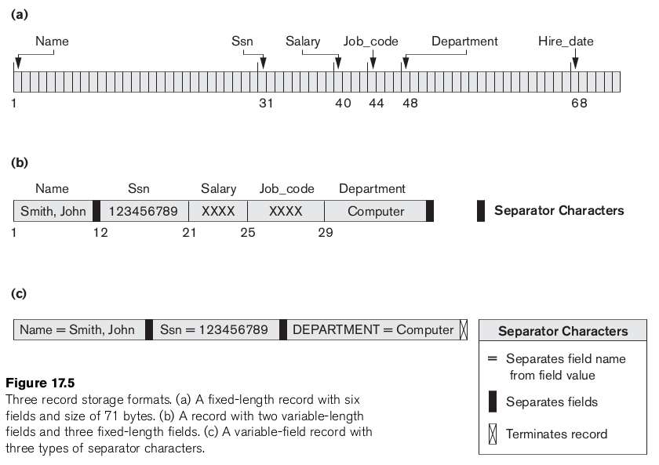

Slide 24
Record Blocking and Spanned Versus Unspanned Records
File records allocated to disk blocks
Spanned records
Larger than a single block
Pointer at end of first block points to block containing remainder of record
Unspanned
Records not allowed to cross block boundaries

Slide 25
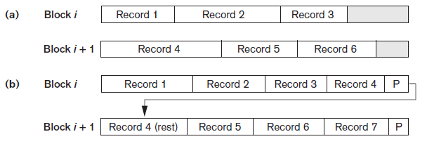

Record Blocking and Spanned Versus Unspanned Records (cont’d.)
Blocking factor (bfr):
Average number of records per block for the file
Bfr=$\left\lfloor B/R\right\rfloor$ with B$≥$R, For a file of fixed-length records of size R bytes and Block size of B bytes
Unused space in each block=B-(bfr*R)
bfr to calculate the number of blocks b needed for a file of r records is : b=(r/bfr), rounded up to the next integer.
Types of record organization (a) Unspanned (b) Spanned

Slide 26
Record Blocking and Spanned Versus Unspanned Records (cont’d.)
Allocating file blocks on disk
Contiguous allocation
Linked allocation
Indexed allocation
File header (file descriptor)
Contains file information needed by system programs
Disk addresses
Format descriptions

Slide 27
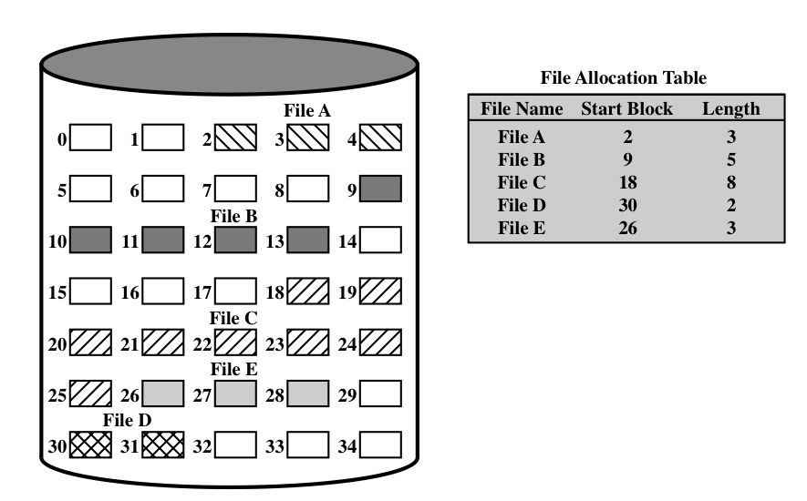
Continuous Allocation

Slide 28
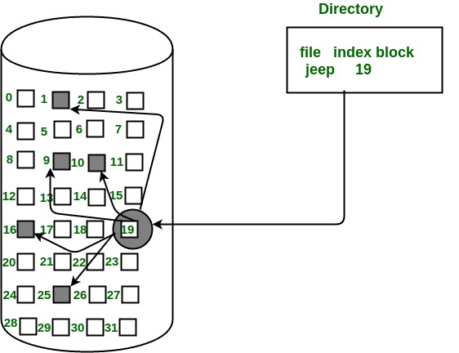
Indexed Allocation

Slide 29
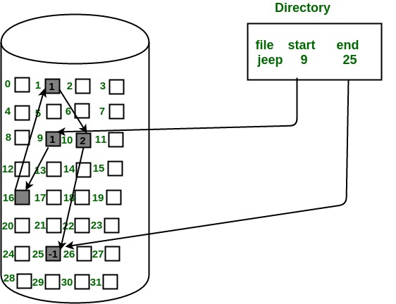
Linked Allocation

Slide 30
Operations on Files
Retrieval operations
No change to file data
Update operations
File change by insertion, deletion, or modification
Records selected based on selection condition

Slide 31
Operations on Files (cont’d.)
Examples of operations for accessing file records
Open
Find
Read
FindNext
Delete
Insert
Close
Scan

Slide 32
Files of Unordered Records (Heap Files)
Heap (or pile) file
Records placed in file in order of insertion
Can be used with both Spanned/un-spanned and fixed length/variable length records
Inserting a new record is very efficient
Searching for a record requires linear search
Deletion techniques
Rewrite the block
Use deletion marker

Slide 33
Files of Unordered Records (Contd..)
For a file of unordered fixed-length records using un-spanned blocks and contiguous allocation, it is straightforward to access any record by its position in the file.
If the file records are numbered (0, 1, 2, ..., r − 1) and the records in each block are numbered (0, 1, ..., bfr − 1), where bfr is the blocking factor,
ith record of the file is located in block= ⎣(i/bfr) ⎦ and,
Record no= (i mod bfr)th record in that block.
Such a file is often called a relative or direct file because records can easily be accessed directly by their relative positions.

Slide 34
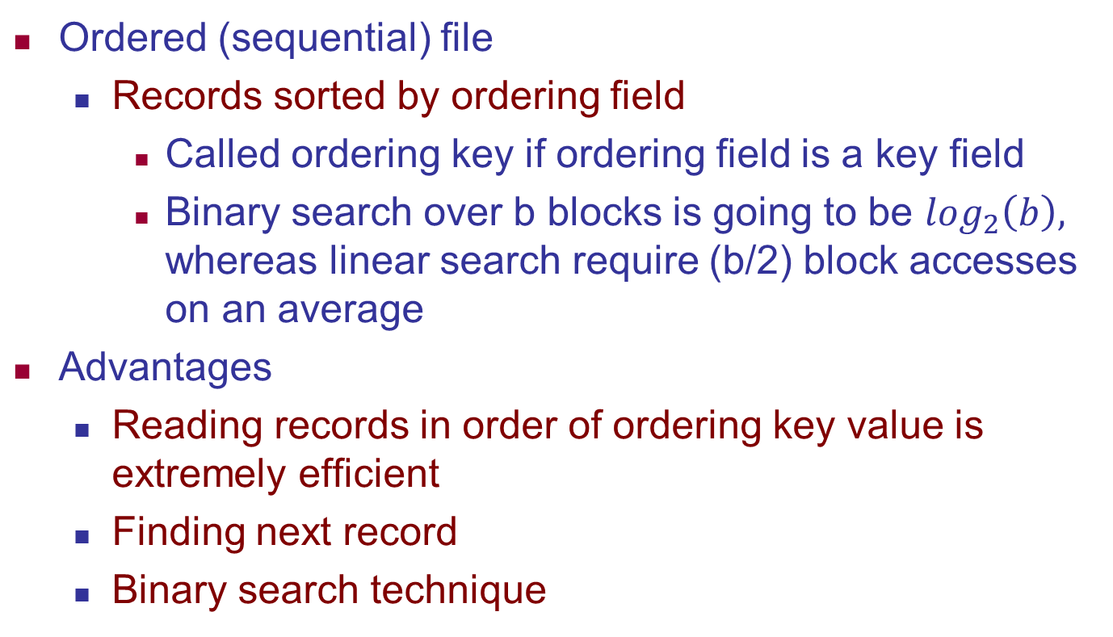
Files of Ordered Records (Sorted Files)
Ordered (sequential) file
Records sorted by ordering field
Called ordering key if ordering field is a key field
Binary search over b blocks is going to be $\log_{2}\left(b\right),$ whereas linear search require (b/2) block accesses on an average
Advantages
Reading records in order of ordering key value is extremely efficient
Finding next record
Binary search technique

Slide 35
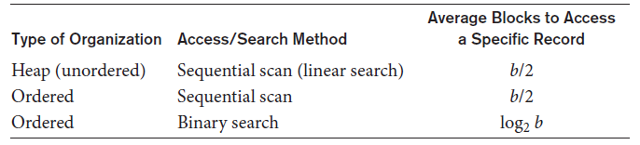
Access Times for Various File Organizations
Average access times for a file of b blocks under basic file organizations

Slide 36
Practice Question
Q2: A file has r=20000 STUDENT records of fixed-length. Each record has the following fields: NAME (30 bytes), SSN (9 bytes), ADDRESS (40 bytes), PHONE (10 bytes), BIRTHDATE (8 bytes), SEX (1 byte), MAJORDEPTCODE (4 bytes), MINORDEPTCODE (4 bytes), CLASSCODE (4 bytes, integer), and DEGREEPROGRAM (3 bytes). An additional byte is used as a deletion marker. The file is stored on the disk whose parameters are given in Q1.
a) Calculate the record size R in bytes.
R = (30 + 9 + 40 + 10 + 8 + 1 + 4 + 4 + 4 + 3) + 1 = 114 bytes
b) Calculate the blocking factor bfr and the number of file blocks b assuming an un-spanned organization.
bfr = floor(B / R) = floor(512 / 114) = 4 records per block
b = ceil(r / bfr) = ceil(20000 / 4) = 5000 blocks

Slide 37
Practice Question Continued..
c) Calculate the average time it takes to find a record by doing a linear search on the file if (i) the file blocks are stored contiguously and double buffering is used, and (ii) the file blocks are not stored contiguously.
For linear search we search on average half the file blocks= 5000/2= 2500 blocks.
(i) If the blocks are stored consecutively, and double buffering is used, the time to read 2500 consecutive blocks= s+rd+(2500*(B/btr)) = 30+12.5+(2500*(512/409.6)) = 3167.5 msec = 3.1675 sec
(ii) If the blocks are scattered over the disk, a seek is needed for each block, so the time is: 2500 * (s + rd + btt) = 2500 * (30 + 12.5 + 1) = 108750 msec = 108.75 sec
d) Assume the file is ordered by SSN; calculate the time it takes to search for a record given its SSN value by doing a binary search.
For binary search, the time to search for a record = : ceil(log 2 b) * (s +rd + btt) = ceil(log 2 5000) * (30 + 12.5 + 1) = 13 * 43.5 = 565.5 msec = 0.5655 sec

Slide 38
Lecture 2

Slide 39
Hashing Techniques
Hash function (randomizing function)
Applied to hash field value of a record
Yields address of the disk block of stored record
Organization called hash file
Search condition is equality condition on the hash field
Hash field typically key field
Hashing also internal search structure
Used when group of records accessed exclusively by one field value

Slide 40
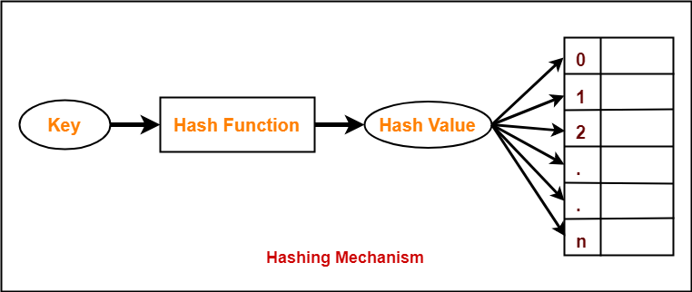
Hashing Technique

Slide 41
Hash Functions
1) Division Method: The hash function can be given as h(x) = x mod M, where x is the key and M is a given number (generally odd number)
Q3: Calculate the hash values of keys 1234 and 5462.
Setting M = 97,
hash values can be calculated as: h(1234) = 1234 % 97 = 70 h(5642) = 5642 % 97 = 16
2) Multiplication Method:
Step 1: Choose a constant A such that 0 < A < 1.
Step 2: Multiply the key k by A.
Step 3: Extract the fractional part of kA.
Step 4: Multiply the result of Step 3 by the size of hash table (m).
Hence, the hash function can be given as: h(k) = Floor [m (kA mod 1)]
Q4: Given a hash table of size 1000, map the key 12345 to an appropriate location in the hash table.
We will use A = 0.618033, m = 1000, and k = 12345
h(12345) = Floor(1000 (12345 *0.618033 mod 1) )
h(12345) = Floor (1000 (7629.617385 mod 1) )
h(12345) = Floor(1000 (0.617385)
h(12345) = Floor(617.385 )= 617

Slide 42
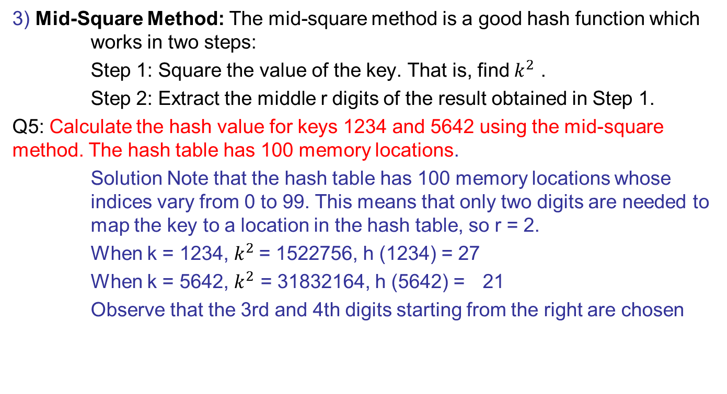
Hash Functions Cont..
3) Mid-Square Method: The mid-square method is a good hash function which works in two steps:
Step 1: Square the value of the key. That is, find $k^{2}$ .
Step 2: Extract the middle r digits of the result obtained in Step 1.
Q5: Calculate the hash value for keys 1234 and 5642 using the mid-square method. The hash table has 100 memory locations.
Solution Note that the hash table has 100 memory locations whose indices vary from 0 to 99. This means that only two digits are needed to map the key to a location in the hash table, so r = 2.
When k = 1234, $k^{2}$= 1522756, h (1234) = 27
When k = 5642, $k^{2}$ = 31832164, h (5642) = 21
Observe that the 3rd and 4th digits starting from the right are chosen

Slide 43
Hash Functions Cont..
4) Folding Method: The folding method works in the following two steps:
Step 1: Divide the key value into a number of parts. That is, divide k into parts k1 , k2 , ..., kn , where each part has the same number of digits except the last part which may have lesser digits than the other parts.
Step 2: Add the individual parts. That is, obtain the sum of k1 + k2 + ... + kn . The hash value is produced by ignoring the last carry, if any.
Q6: Given a hash table of 100 locations, calculate the hash value using folding method for keys 5678, 321, and 34567.
Since there are 100 memory locations to address, we will break the key into parts where each part (except the last) will contain two digits. The hash values can be obtained as shown below:
key 5678 321 34567
Parts 56 and 78 32 and 1 34, 56 and 7
Sum 134 33 97
Hash value 34 (ignore the last carry) 33 97

Slide 44
Hashing Techniques
Internal hashing
Hash table
Collision
Hash field value for inserted record hashes to address already containing a different record
Collision resolution
Open addressing
Chaining
Multiple hashing

Slide 45
Hashing Techniques (cont’d.)
External hashing for disk files
Target address space made of buckets
Bucket: one disk block or contiguous blocks
Hashing function maps a key into relative bucket
Table in file header converts bucket number to disk block address
Collision problem less severe with buckets
Static hashing
Fixed number of buckets allocated

Slide 46
Hashing Techniques (cont’d.)
Hashing techniques that allow dynamic file expansion
Extendible hashing
File performance does not degrade as file grows
Dynamic hashing
Maintains tree-structured directory
Linear hashing
Allows hash file to expand and shrink buckets without needing a directory

Slide 47
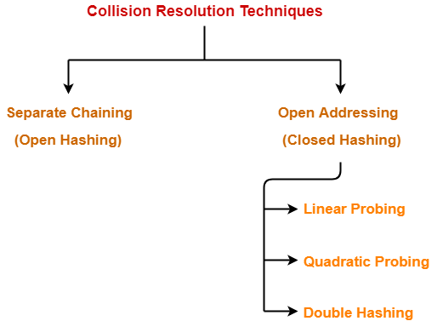

Slide 48
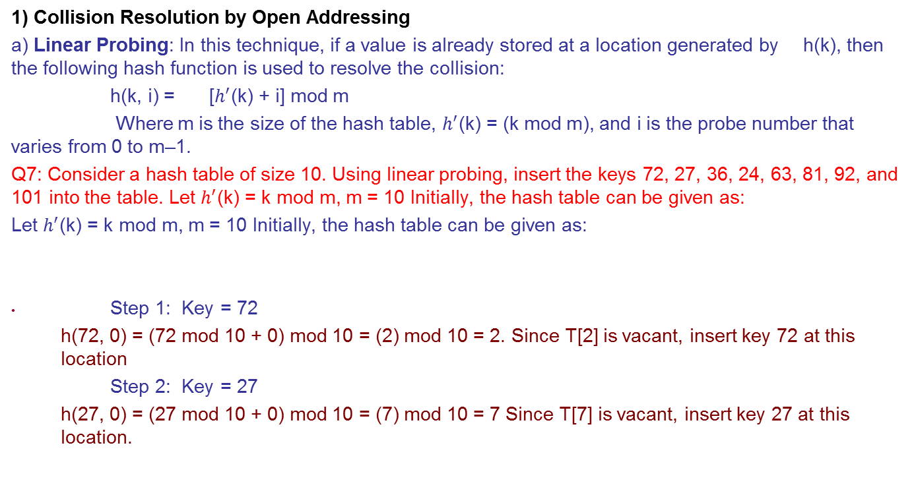
Collisions and Collision Resolution Techniques
1) Collision Resolution by Open Addressing
a) Linear Probing: In this technique, if a value is already stored at a location generated by h(k), then the following hash function is used to resolve the collision:
h(k, i) = [$h^{′}$(k) + i] mod m
Where m is the size of the hash table, $h^{′}$(k) = (k mod m), and i is the probe number that varies from 0 to m–1.
Q7: Consider a hash table of size 10. Using linear probing, insert the keys 72, 27, 36, 24, 63, 81, 92, and 101 into the table. Let $h^{′}$(k) = k mod m, m = 10 Initially, the hash table can be given as:
Let $h^{′}$(k) = k mod m, m = 10 Initially, the hash table can be given as:
Step 1: Key = 72
h(72, 0) = (72 mod 10 + 0) mod 10 = (2) mod 10 = 2. Since T[2] is vacant, insert key 72 at this location
Step 2: Key = 27
h(27, 0) = (27 mod 10 + 0) mod 10 = (7) mod 10 = 7 Since T[7] is vacant, insert key 27 at this location.

Slide 49
Collisions and Collision Resolution Techniques cont..
Step 3 :Key = 36
h(36, 0) = (36 mod 10 + 0) mod 10 = (6) mod 10 = 6 Since T[6] is vacant, insert key 36 at this location
Step 4 Key = 24
h(24, 0) = (24 mod 10 + 0) mod 10 = (4) mod 10 = 4 Since T[4] is vacant, insert key 24 at this location.
Step 5 Key = 63
h(63, 0) = (63 mod 10 + 0) mod 10 = (3) mod 10 = 3 Since T[3] is vacant, insert key 63 at this location
Step 6 Key = 81
h(81, 0) = (81 mod 10 + 0) mod 10 = (1) mod 10 = 1 Since T[1] is vacant, insert key 81 at this location.
Step 7 Key = 92
h(92, 0) = (92 mod 10 + 0) mod 10 = (2) mod 10 = 2

Slide 50
Collisions and Collision Resolution Techniques cont..
Now T[2] is occupied, so we cannot store the key 92 in T[2]. Therefore, try again for the next location.
Thus probe, i = 1, this time. Key = 92 h(92, 1) = (92 mod 10 + 1) mod 10 = (2 + 1) mod 10 = 3 Now T[3] is occupied, so we cannot store the key 92 in T[3]. Therefore, try again for the next location.
Thus probe, i = 2, this time. Key = 92 h(92, 2) = (92 mod 10 + 2) mod 10 = (2 + 2) mod 10 = 4 Now T[4] is occupied, so we cannot store the key 92 in T[4]. Therefore, try again for the next location.
Thus probe, i = 3, this time. Key = 92 h(92, 3) = (92 mod 10 + 3) mod 10 = (2 + 3) mod 10 = 5 Since T[5] is vacant, insert key 92 at this location.
Step 8 Key = 101
h(101, 0) = (101 mod 10 + 0) mod 10 = (1) mod 10 = 1.Now T[1] is occupied, so we cannot store the key 101 in T[1]. Therefore, try again for the next location.
Thus probe, i = 1, this time. Key = 101, h(101, 1) = (101 mod 10 + 1) mod 10 = (1 + 1) mod 10 = 2
T[2] is also occupied, so we cannot store the key in this location. The procedure will be repeated until the hash function generates the address of location 8 which is vacant and can be used to store the value in it.

Slide 51
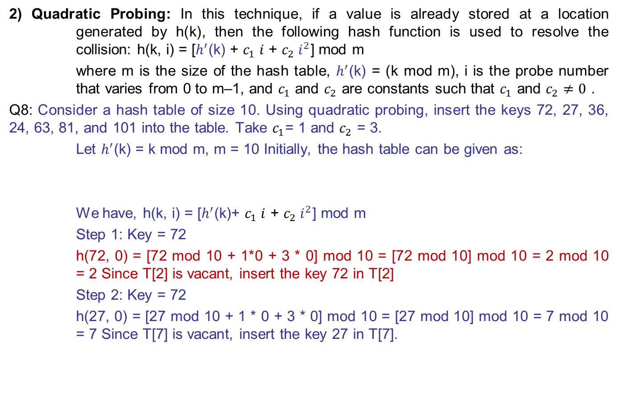
Collisions and Collision Resolution Techniques cont..
2) Quadratic Probing: In this technique, if a value is already stored at a location generated by h(k), then the following hash function is used to resolve the collision: h(k, i) = [$h^{′}$(k) + $c_{1} i$ + $c_{2} i^{2}$] mod m
where m is the size of the hash table, $h^{′}$(k) = (k mod m), i is the probe number that varies from 0 to m–1, and $c_{1}$ and $c_{2}$ are constants such that $c_{1}$ and $c_{2}≠0$ .
Q8: Consider a hash table of size 10. Using quadratic probing, insert the keys 72, 27, 36, 24, 63, 81, and 101 into the table. Take $c_{1}$= 1 and $c_{2}$ = 3.
Let $h^{′}$(k) = k mod m, m = 10 Initially, the hash table can be given as:
We have, h(k, i) = [$h^{′}$(k)+ $c_{1} i$ + $c_{2} i^{2}$] mod m
Step 1: Key = 72
h(72, 0) = [72 mod 10 + 1*0 + 3 * 0] mod 10 = [72 mod 10] mod 10 = 2 mod 10 = 2 Since T[2] is vacant, insert the key 72 in T[2]
Step 2: Key = 72
h(27, 0) = [27 mod 10 + 1 * 0 + 3 * 0] mod 10 = [27 mod 10] mod 10 = 7 mod 10 = 7 Since T[7] is vacant, insert the key 27 in T[7].

Slide 52
Collisions and Collision Resolution Techniques cont..
Step 3 Key = 36
h(36, 0) = [36 mod 10 + 1 *0 + 3 * 0] mod 10 = [36 mod 10] mod 10 = 6 mod 10 = 6 Since T[6] is vacant, insert the key 36 in T[6].
Step 4 Key = 24
h(24, 0) = [24 mod 10 + 1 * 0 + 3 * 0] mod 10 = [24 mod 10] mod 10 = 4 mod 10 = 4 Since T[4] is vacant, insert the key 24 in T[4].
Step 5 Key = 63
h(63, 0) = [63 mod 10 + 1 * 0 + 3 * 0] mod 10 = [63 mod 10] mod 10 = 3 mod 10 = 3 Since T[3] is vacant, insert the key 63 in T[3].
Step 6 Key = 81
h(81,0) = [81 mod 10 + 1 * 0 + 3 * 0] mod 10 = [81 mod 10] mod 10 = 81 mod 10 = 1 Since T[1] is vacant, insert the key 81 in T[1].

Slide 53
Collisions and Collision Resolution Techniques cont..
Step 7 Key = 101
h(101,0) = [101 mod 10 + 1 * 0 + 3 * 0] mod 10 = [101 mod 10 + 0] mod 10 = 1 mod 10 = 1.
Since T[1] is already occupied, the key 101 cannot be stored in T[1]. Therefore, try again for next location.
Thus probe, i = 1, this time. Key = 101
h(101,0) = [101 mod 10 + 1 * 1 + 3 * 1] mod 10
[101 mod 10 + 1 + 3] mod 10
= [101 mod 10 + 4] mod 10
= [1 + 4] mod 10
= 5 mod 10 = 5
Since T[5] is vacant, insert the key 101 in T[5]

Slide 54
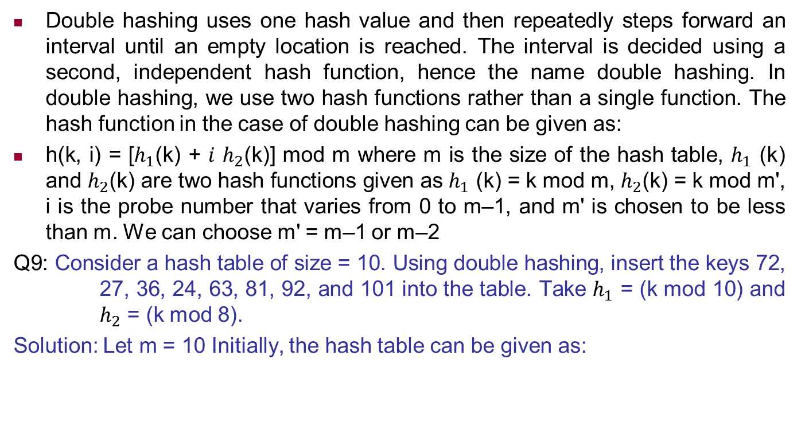
Double Hashing
Double hashing uses one hash value and then repeatedly steps forward an interval until an empty location is reached. The interval is decided using a second, independent hash function, hence the name double hashing. In double hashing, we use two hash functions rather than a single function. The hash function in the case of double hashing can be given as:
h(k, i) = [$h_{1}$(k) + $i$ $h_{2}$(k)] mod m where m is the size of the hash table, $h_{1}$ (k) and $h_{2}$(k) are two hash functions given as $h_{1}$ (k) = k mod m, $h_{2}$(k) = k mod m', i is the probe number that varies from 0 to m–1, and m' is chosen to be less than m. We can choose m' = m–1 or m–2
Q9: Consider a hash table of size = 10. Using double hashing, insert the keys 72, 27, 36, 24, 63, 81, 92, and 101 into the table. Take $h_{1}$ = (k mod 10) and $h_{2}$ = (k mod 8).
Solution: Let m = 10 Initially, the hash table can be given as:

Slide 55
Double Hashing contd..
Step 1 Key = 72
h(72, 0) = [72 mod 10 + (0 * 72 mod 8)] mod 10 = [2 + (0 * 0)] mod 10 = 2 mod 10 = 2 Since T[2] is vacant, insert the key 72 in T[2]
Step 2 Key = 27
h(27, 0) = [27 mod 10 + (0 * 27 mod 8)] mod 10 = [7 + (0 * 3)] mod 10 = 7 mod 10 = 7 Since T[7] is vacant, insert the key 27 in T[7].
Step 3 Key = 36
h(36, 0) = [36 mod 10 + (0 * 36 mod 8)] mod 10 = [6 + (0 * 4)] mod 10 = 6 mod 10 = 6 Since T[6] is vacant, insert the key 36 in T[6].
Step 4 Key = 24
h(24, 0) = [24 mod 10 + (0 * 24 mod 8)] mod 10 = [4 + (0 * 0)] mod 10 = 4 mod 10 = 4 Since T[4] is vacant, insert the key 24 in T[4].
Step 5 Key = 63
h(63, 0) = [63 mod 10 + (0 * 63 mod 8)] mod 10 = [3 + (0 * 7)] mod 10 = 3 mod 10 = 3 Since T[3] is vacant, insert the key 63 in T[3]

Slide 56
Double Hashing contd..
Step 6 Key = 81
h(81, 0) = [81 mod 10 + (0 * 81 mod 8)] mod 10 = [1 + (0 * 1)] mod 10 = 1 mod 10 = 1 Since T[1] is vacant, insert the key 81 in T[1]
Step 7 Key = 92
h(92, 0) = [92 mod 10 + (0 * 92 mod 8)] mod 10 = [2 + (0 * 4)] mod 10 = 2 mod 10 = 2 Now T[2] is occupied, so we cannot store the key 92 in T[2]. Therefore, try again for the next location.
Thus probe, i = 1, this time. Key = 92
h(92, 1) = [92 mod 10 + (1 * 92 mod 8)] mod 10 = [2 + (1 * 4)] mod 10 = (2 + 4) mod 10 = 6 mod 10 = 6 Now T[6] is occupied, so we cannot store the key 92 in T[6]. Therefore, try again for the next location.
Thus probe, i = 2, this time. Key = 92
h(92, 2) = [92 mod 10 + (2 * 92 mod 8)] mod 10 = [2 + (2 * 4)] mod 10 = [2 + 8] mod 10 = 10 mod 10 = 0 Since T[0] is vacant, insert the key 92 in T[0]
Step 8 Key = 101
h(101, 0) = [101 mod 10 + (0 * 101 mod 8)] mod 10 = [1 + (0 * 5)] mod 10 = 1 mod 10 = 1 Now T[1] is occupied, so we cannot store the key 101 in T[1]. Therefore, try again for the next location. Thus probe, i = 1, this time. Key = 101 h(101, 1) = [101 mod 10 + (1 * 101 mod 8)] mod 10 = [1 + (1 * 5)] mod 10 = [1 + 5] mod 10 = 6

Slide 57
Double Hashing contd..
Now T[6] is occupied, so we cannot store the key 101 in T[6]. Therefore, try again for the next location with probe i = 2. Repeat the entire process until a vacant location is found. You will see that we have to probe many times to insert the key 101 in the hash table. Although double hashing is a very efficient algorithm, it always requires m to be a prime number. In our case m=10, which is not a prime number, hence, the degradation in performance. Had m been equal to 11, the algorithm would have worked very efficiently. Thus, we can say that the performance of the technique is sensitive to the value of m.

Slide 58
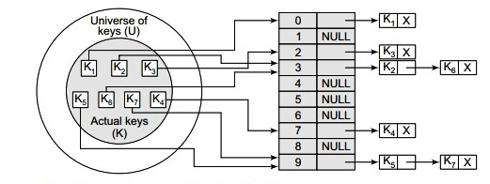
Collision Resolution by Chaining
In chaining, each location in a hash table stores a pointer to a linked list that contains all the key values that were hashed to that location. That is, location l in the hash table points to the head of the linked list of all the key values that hashed to l. However, if no key value hashes to l, then location l in the hash table contains NULL

Slide 59
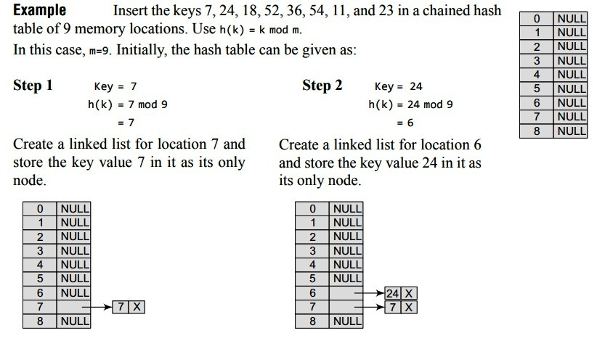

Slide 60
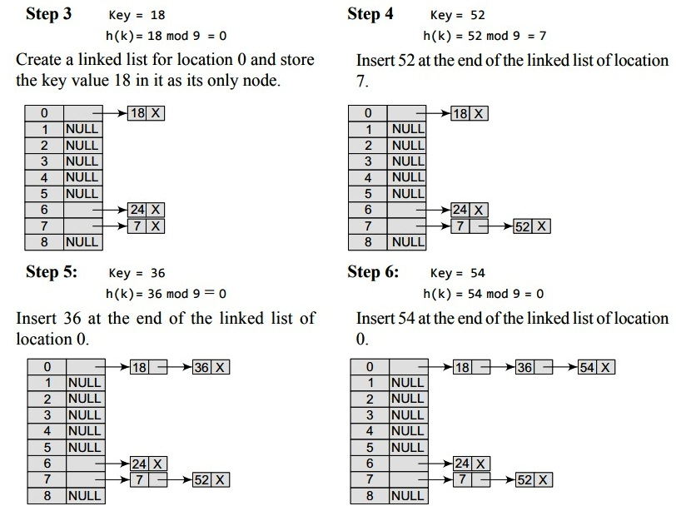

Slide 61
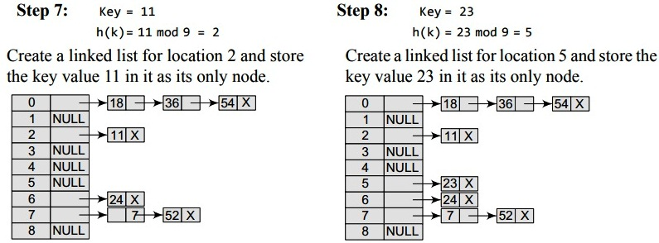

Slide 62
Lecture 3
Indexing Structures for Files

Slide 63
Overview of Indexing
a file already exists with some primary organization such as the unordered, ordered, or hashed organizations, then auxiliary access structures called indexes are required.
Indexes used to speed up record retrieval in response to certain search conditions
Any field can be used to create an index
Types of Indexing:
single-level ordered indexes—primary, secondary, and clustering
Multilevel indexes (B-Tree/B+Tree)

Slide 64
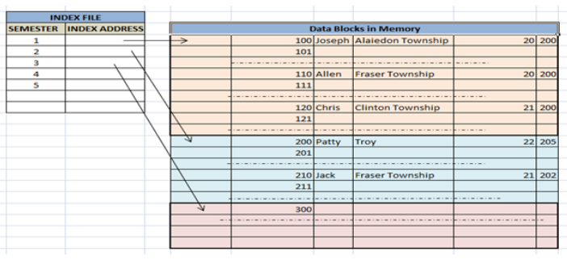

Slide 65
Types of Single-Level Ordered Indexes
Ordered index similar to index in a textbook
Indexing field (attribute)
Index stores each value of the index field with list of pointers to all disk blocks that contain records with that field value
Values in index are ordered
Primary index
Specified on the ordering key field of ordered file of records

Slide 66
Types of Single-Level Ordered Indexes (cont’d.)
Clustering index
Used if numerous records can have the same value for the ordering field
Secondary index
Can be specified on any nonordering field
Data file can have several secondary indexes

Slide 67
Primary Indexes
Ordered file with two fields
Primary key, K(i)
Pointer to a disk block, P(i)
One index entry in the index file for each block in the data file
Indexes may be dense or sparse
Dense index has an index entry for every search key value in the data file
Sparse index has entries for only some search values

Slide 68
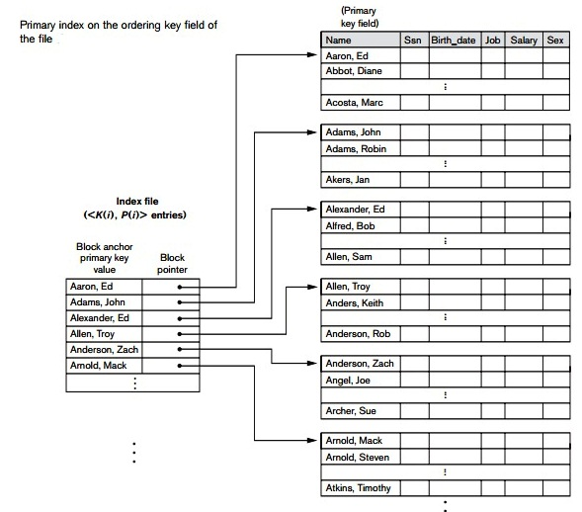

Slide 69
Primary Indexes (cont’d.)
Major problem: insertion and deletion of records
Move records around and change index values
Solutions
Use unordered overflow file
Use linked list of overflow records

Slide 70
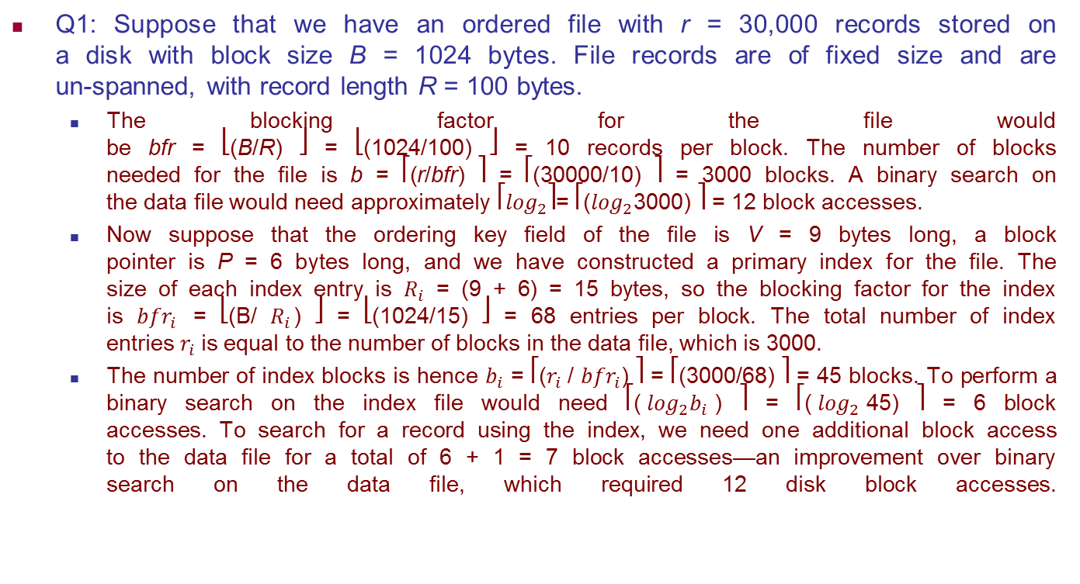
Practice Question :Primary Index
Q1: Suppose that we have an ordered file with r = 30,000 records stored on a disk with block size B = 1024 bytes. File records are of fixed size and are un-spanned, with record length R = 100 bytes.
The blocking factor for the file would be bfr = ⎣(B/R) ⎦ = ⎣(1024/100) ⎦ = 10 records per block. The number of blocks needed for the file is b = ⎡(r/bfr) ⎤ = ⎡(30000/10) ⎤ = 3000 blocks. A binary search on the data file would need approximately ⎡$\log_{2}$⎤= ⎡($\log_{2}$3000) ⎤ = 12 block accesses.
Now suppose that the ordering key field of the file is V = 9 bytes long, a block pointer is P = 6 bytes long, and we have constructed a primary index for the file. The size of each index entry is $R_{i}$ = (9 + 6) = 15 bytes, so the blocking factor for the index is ${bfr}_{i}$ = ⎣(B/ $R_{i}$) ⎦ = ⎣(1024/15) ⎦ = 68 entries per block. The total number of index entries $r_{i}$is equal to the number of blocks in the data file, which is 3000.
The number of index blocks is hence $b_{i}$ = ⎡($r_{i}$/ ${bfr}_{i}$) ⎤ = ⎡(3000/68) ⎤ = 45 blocks. To perform a binary search on the index file would need ⎡($\log_{2}b_{i}$) ⎤ = ⎡($\log_{2}$45) ⎤ = 6 block accesses. To search for a record using the index, we need one additional block access to the data file for a total of 6 + 1 = 7 block accesses—an improvement over binary search on the data file, which required 12 disk block accesses.

Slide 71
Clustering Indexes
Clustering field
File records are physically ordered on a nonkey field without a distinct value for each record
Ordered file with two fields
Same type as clustering field
Disk block pointer

Slide 72
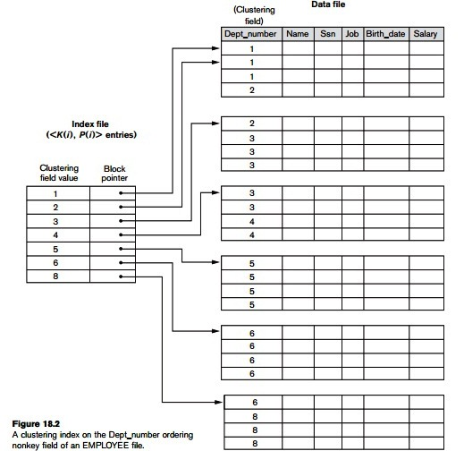

Slide 73
Secondary Indexes
Provide secondary means of accessing a data file
Some primary access exists
Ordered file with two fields
Indexing field, K(i)
Block pointer or record pointer, P(i)
Usually need more storage space and longer search time than primary index
Improved search time for arbitrary record

Slide 74
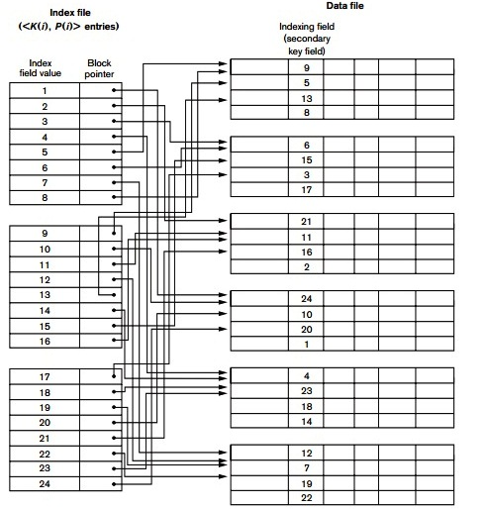

Slide 75
Practice Question :Secondary Index
Q2: Consider the file of Example 1 with r = 30,000 fixed-length records of size R = 100 bytes stored on a disk with block size B = 1024 bytes. The file has b = 3000 blocks, as calculated in Q1. Suppose we want to search for a record with a specific value for the secondary key—a non ordering key field of the file that is V = 9 bytes long.
Without the secondary index, to do a linear search on the file would require b/2 = 3000/2 = 1500 block accesses on the average. Suppose that we construct a secondary index on that non-ordering key field of the file. As in Q1, a block pointer is P = 6 bytes long, so each index entry is Ri = (9 + 6) = 15 bytes, and the blocking factor for the index is bfri = ⎣(B/Ri) ⎦ = ⎣(1024/15) ⎦ = 68 entries per block. In a dense secondary index such as this, the total number of index entries ri is equal to the number of records in the data file, which is 30,000. The number of blocks needed for the index is hence b i = ⎡(ri/bfri) ⎤ = ⎡(3000/68) ⎤ = 442 blocks. A binary search on this secondary index needs ⎡(log2bi) ⎤ = ⎡(log2442) ⎤ = 9 block accesses.
To search for a record using the index, we need an additional block access to the data file for a total of 9 + 1 = 10 block accesses—a vast improvement over the 1500 block accesses needed on the average for a linear search, but slightly worse than the 7 block accesses required for the primary index. This difference arose because the primary index was nondense and hence shorter, with only 45 blocks in length

Slide 76
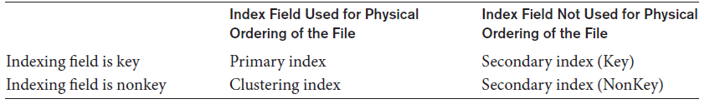
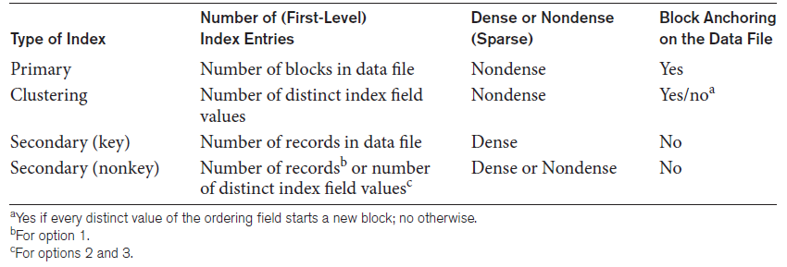
Types of Single-Level Ordered Indexes (cont’d.)
Types of indexes based on the properties of the indexing field
Properties of index types

Slide 77
Multilevel Indexes
Designed to greatly reduce remaining search space as search is conducted
Index file
Considered first (or base level) of a multilevel index
Second level
Primary index to the first level
Third level
Primary index to the second level

Slide 78
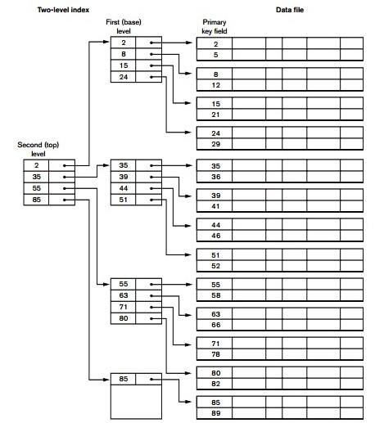

Slide 79
Practice Question: Multilevel Indexes
Q3: Suppose that the dense secondary index of Q2 is converted into a multilevel index.
We calculated the index blocking factor bfri = 68 index entries per block, which is also the fan-out fo for the multilevel index; the number of first level blocks b1 = 442 blocks was also calculated. The number of second-level blocks will be b2 = ⎡(1/fo) ⎤ = ⎡(442/68) ⎤ = 7 blocks, and the number of third-level blocks will be b3 = ⎡(b2/fo) ⎤ = ⎡(7/68) ⎤ = 1 block. Hence, the third level is the top level of the index, and t = 3.
To access a record by searching the multilevel index, we must access one block at each level plus one block from the data file, so we need t + 1 = 3+ 1 = 4 block accesses. Compare this to Q2, where 10 block accesses were needed when a single-level index and binary search were used

Slide 80
Dynamic Multilevel Indexes Using B-Trees and B+ -Trees
Tree data structure terminology
Tree is formed of nodes
Each node (except root) has one parent and zero or more child nodes
Leaf node has no child nodes
Unbalanced if leaf nodes occur at different levels
Nonleaf node called internal node
Subtree of node consists of node and all descendant nodes

Slide 81
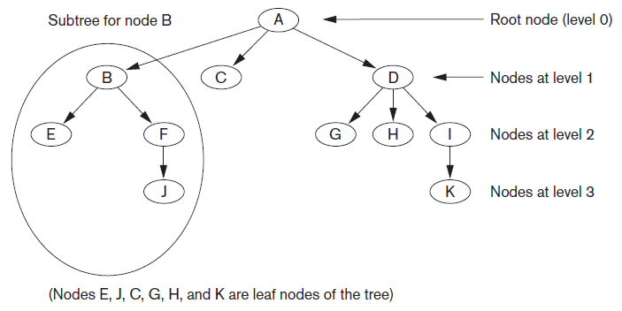
Tree Data Structure
A tree data structure that shows an unbalanced tree

Slide 82
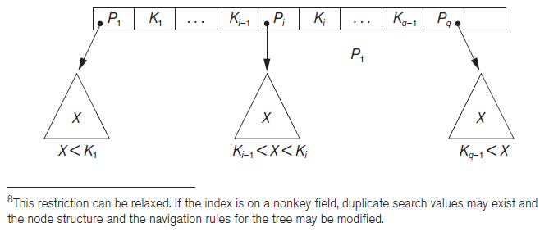
Search Trees and B-Trees
Search tree used to guide search for a record
Given value of one of record’s fields
A node in a search tree with pointers to subtrees below it

Slide 83
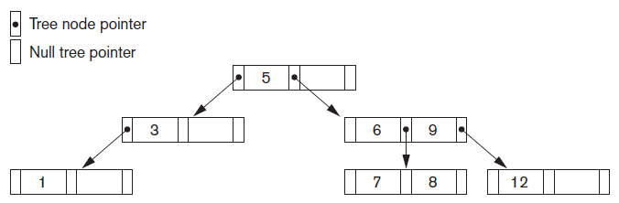
Search Trees and B-Trees (cont’d.)
Algorithms necessary for inserting and deleting search values into and from the tree
A search tree of order p = 3

Slide 84
B-Trees
Provide multi-level access structure
Tree is always balanced
Space wasted by deletion never becomes excessive
Each node is at least half-full
Each node in a B-tree of order p can have at most p-1 search values

Slide 85
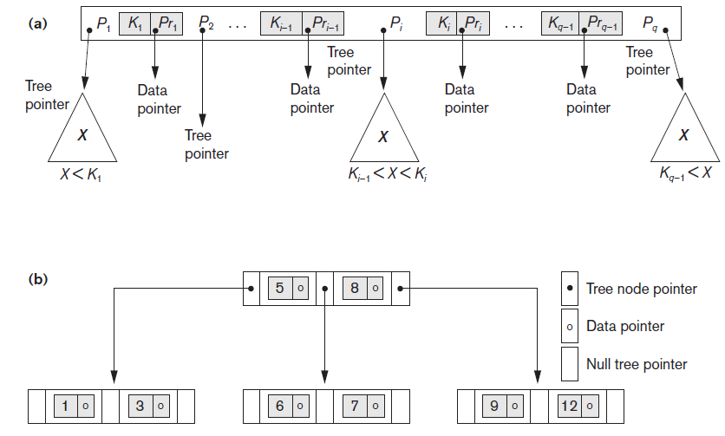
B-Tree Structures
B-tree structures (a) A node in a B-tree with q−1 search values (b) A B-tree of order p=3. The values were inserted in the order 8, 5, 1, 7, 3, 12, 9, 6

Slide 86
B+ -Trees
Data pointers stored only at the leaf nodes
Leaf nodes have an entry for every value of the search field, and a data pointer to the record if search field is a key field
For a nonkey search field, the pointer points to a block containing pointers to the data file records
Internal nodes
Some search field values from the leaf nodes repeated to guide search

Slide 87
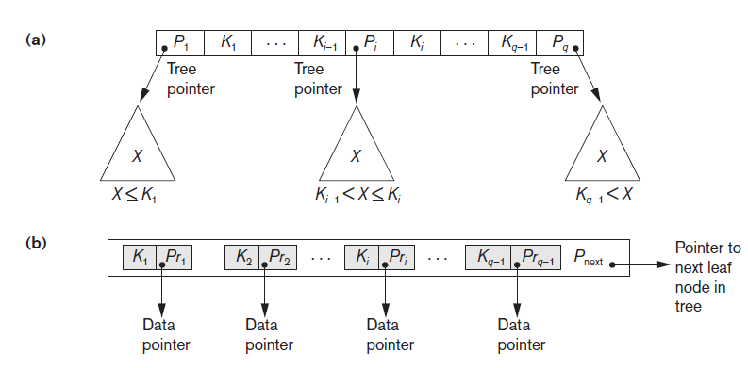
B+ -Trees (cont’d.)
The nodes of a B+-tree (a) Internal node of a B+-tree with q−1 search values (b) Leaf node of a B+-tree with q−1 search values and q−1 data pointers

Slide 88
Practice Question: Dynamic Multilevel indexes
Q4: Suppose that the search field is a non-ordering key field, and we construct a B-tree on this field with p = 23.
Assume that each node of the B-tree is 69 percent full. Each node, on the average, will have p * 0.69 = 23 * 0.69 or approximately 16 pointers and, hence, 15 search key field values. The average fan-out fo = 16. We can start at the root and see how many values and pointers can exist, on the average, at each subsequent level:
Root: 1 node 15 key entries 16 pointers Level 1: 16 nodes 240 key entries 256 pointers Level 2: 256 nodes 3840 key entries 4096 pointers Level 3: 4096 nodes 61,440 key entries
At each level, we calculated the number of key entries by multiplying the total number of pointers at the previous level by 15, the average number of entries in each node. Hence, for the given block size, pointer size, and search key field size, a two level B-tree holds 3840 + 240 + 15 = 4095 entries on the average; a three-level B-tree holds 65,535 entries on the average.

Slide 89
Thanks!!

